Slide 1
Artificial Neural Networks

Slide 2
Topics
Biological neurons

Slide 3
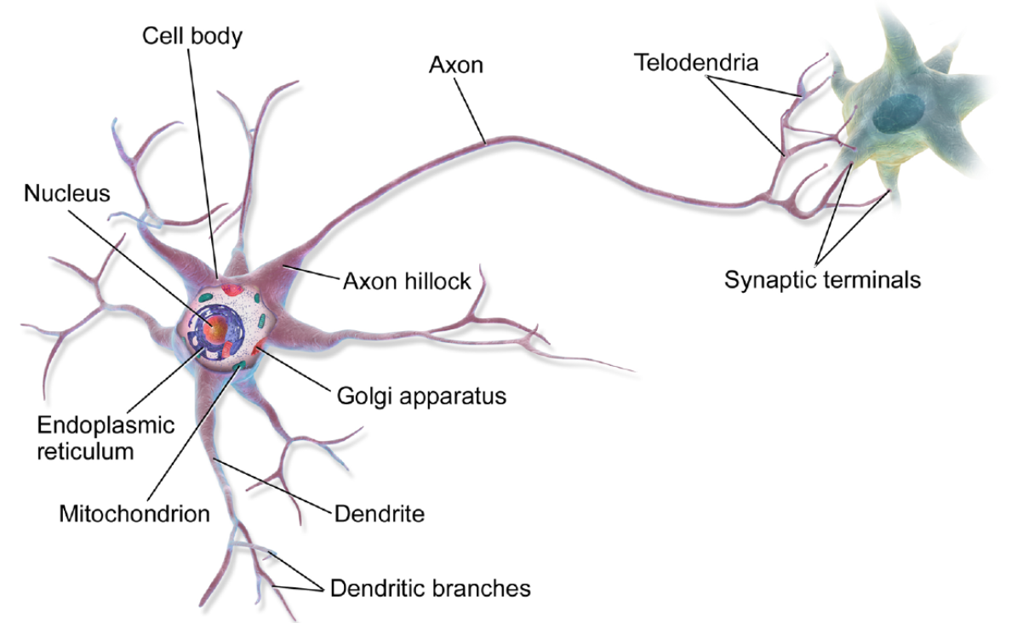
Biological neurons (1)
An Artificial Neural Network (ANN) is a model inspired by the networks of biological neurons found in our brains
A neuron is a cell found in animal brains composed of:
cell body
containing the nucleus and most of the cell’s complex components
dendrites
many branching extensions
axon
a very long extension
Near its extremity the axon splits off into many branches called telodendria
At the tip of these branches are minuscule structures called synapses
connected to the dendrites or cell bodies of other neurons

Slide 4
Biological neurons (2)
Neurons produce short electrical impulses called action potentials
travel along the axons
make synapses release chemical signals called neurotransmitters
When a neuron receives a sufficient amount of these neurotransmitters within a few milliseconds, it fires its own electrical impulses
actually, it depends on the neurotransmitters
some inhibit the neuron from firing
Individual neurons seem to behave in a simple way, but they are organized in a network of billions
each neuron typically connected to thousands of other neurons
highly complex computations can be performed by a network of fairly simple neurons.
The architecture of biological neural networks is still the subject of active research, but some parts of the brain have been mapped, and it seems that neurons are often organized in consecutive layers, especially in the cerebral cortex

Slide 5
XXXx
ANN are inspired by this networks of biological neurons, however they have gradually become quite different
some researchers even argue that we should drop the biological analogy altogether (e.g., by saying “units” rather than “neurons”), lest we restrict our creativity to biologically plausible systems.

Slide 6
XXXx
XXXX

Slide 7
XXXx
XXXX

Slide 8
XXXx
XXXX

Slide 9
XXXx
XXXX

Slide 10
XXXx
XXXX

Slide 11
XXXx
XXXX

Slide 12
Exercise
1 - xxxx

